Slide 1
Omega Corp.
Project 026
Group: Omega
TA: Mike Hegedus

Slide 2
Presentation Outline
Problem and Solution
The Project
Current State
Future Work

Slide 3

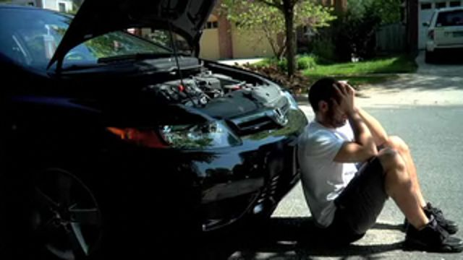
The Problem
Car battery drains
Owner is unaware
Battery dies, car is unusable

Slide 4

The Solution
Notify user prior to battery failure

Slide 5
(BOB VMS)
Bolt-On Battery Vitality Monitoring System

Slide 6

Requirements
Measure battery health
Determine when to alert user
Alert user
Avoid draining the car battery

Slide 7
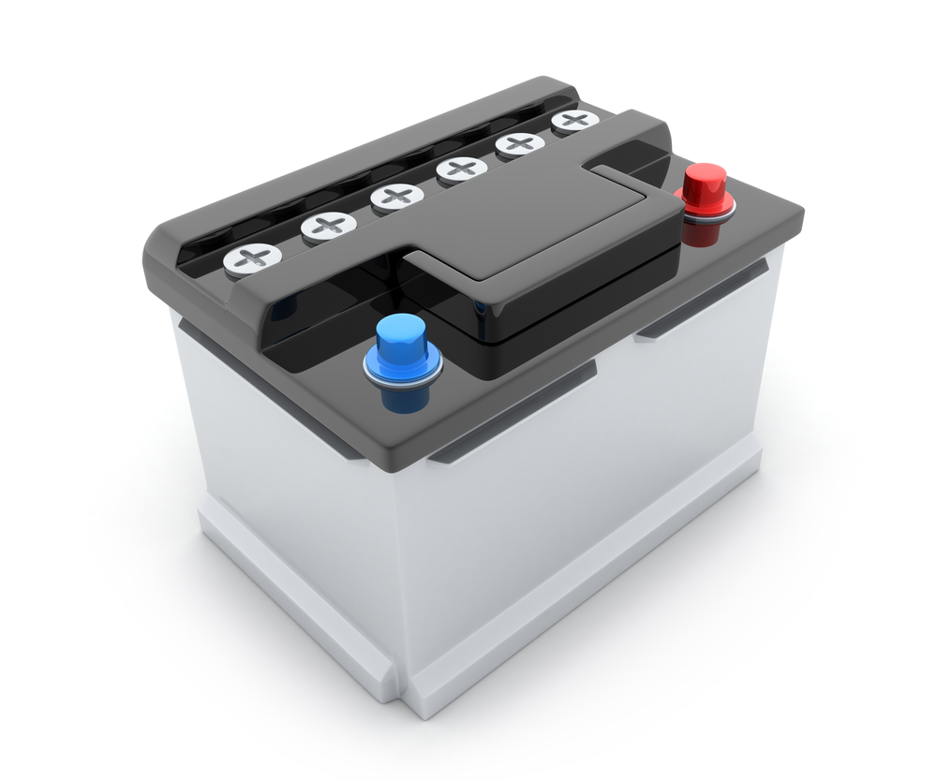



Process
Car battery holds voltage
Microcontroller reads voltage, prompts modem
Modem sends message
Owner is notified

Slide 8
Current Progress
Purchased hardware
Created rough circuit diagram and code
Determined battery threshold
Established teams

Slide 9
Purchased hardware
Arduino microcontroller
Resistors
LEDs
Mosfet
Battery snap
Modem

Slide 10
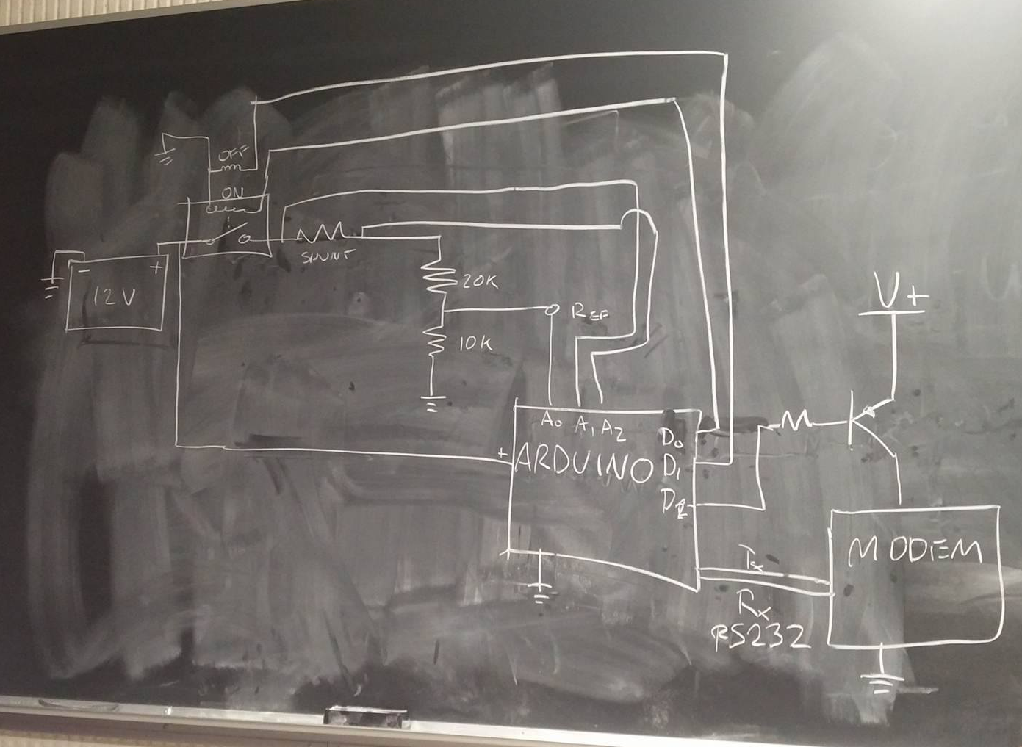
Rough Circuit
*Circuit designed with the aid of Kelvin Stokes

Slide 11
Basic Algorithm
1.Check voltage every X minutes
2. If volts is close to critical voltage
then signal a modem to send message
3. Message is sent to the user
4. If the user replies “Yes” then disconnect the battery using the latching relay. ← (possible upgrade)

Slide 12
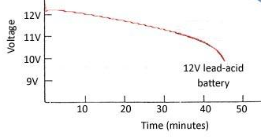
Determined Battery Threshold
Danger at 12.1 V
Critical at 11.8 V

Slide 13
Teams
Arduino Programming
Circuit Integration (BOB VMS coordinator)
Device Communications
Project Management (Mike Hegedus)

Slide 14
Future work
Learn how to program the arduino to communicate with the modem
Calculate and perfect circuit design
Build lab proof of concept
Debugging
Possibly include remote battery disabler

Slide 15
Acknowledgments
We would like to thank Mike Hegedus for his comments and contributions. Further thanks to Kelvin Stokes for his contributions.

Slide 16
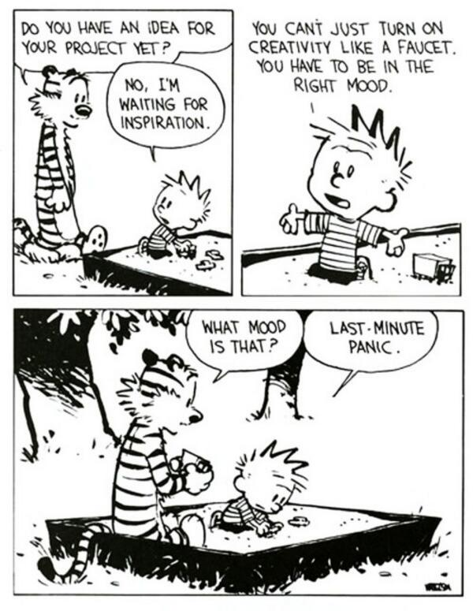
Thanks for Listening! ;-)

Slide 17

Questions?
INSERT PIC

